Slide 1
USE CASE
Title: User Behavior Analysis and Video Recommendation System for Streaming Platforms Using K-Means Clustering
Aim:
To develop an effective video recommendation system for streaming platforms by analyzing user behavior through K-Means clustering and sequential models like LSTM, enhancing user experience and content engagement.
Problem Statement:
Scope:
The scope of User Behavior Analysis and Video Recommendation system for streaming platforms using K-Means Clustering and LSTM models covers multiple critical areas like:
User Segmentation: Implementing K-Means clustering for user segmentation based on viewing patterns.
Temporal Behavior Analysis: Utilizing sequential models, specifically LSTM, to predict future user interactions and recommend videos tailored to individual preferences.
Trend Forecasting: Evaluating the effectiveness of the proposed recommendation system in enhancing user satisfaction and engagement on streaming platforms like YouTube.
Methodologies:
User Behavior Analysis and Video Recommendation system involves several key methodologies and approaches aimed at effectively identifying effective claims like:
Data preprocessing:
Data Cleaning: Handling missing values, filtering irrelevant data points, and formatting timestamps.
Feature Engineering: Creating features like session duration, day-of-week, time-of-day, and interaction events (e.g., likes, comments, shares).
Normalization/Standardization: Scaling numerical features for clustering and sequential models
To develop an efficient recommendation system for streaming platforms like Netflix, spotify and youtube.

Slide 2
2. Data preprocessing:
K-Means Algorithm: Segmenting users based on viewing patterns (e.g., duration watched, interaction frequency) to group users with similar behaviors.
Hyperparameter Tuning: Experimenting with different numbers of clusters (K) to find the optimal grouping of users.
3. Video Recommendations:
Collaborative Filtering: Using Singular Value Decomposition (SVD) for matrix factorization to recommend videos based on user-video interaction history.
Sequential Models (RNN/LSTM): Using Recurrent Neural Networks (RNN) and Long Short-Term Memory (LSTM) networks to forecast user engagement over time, providing future video recommendations based on past behavior.
4.Visualization:
User Clusters: Visualizing user segments based on K-Means clustering (e.g., duration watched vs. interaction events).
Future Interaction Forecasting: Plotting future interaction predictions for individual users using LSTM models.
Dataset Information:
Dataset name: Streaming user data for video recommendations
Dataset Source:
The dataset is based on user interaction data from a video streaming platform, which includes the following attributes:
User_ID: Unique identifier for each user.
Video_ID: Unique identifier for each video/content.
Timestamp: The time at which the user interacted with the video.
Duration_Watched (minutes): Total minutes the user spent watching a particular video.
Playback Quality: The video playback quality settings (e.g., 480p, 720p, 1080p).
Genre: Video genre (e.g., Action, Comedy, Drama).
Subscription Status: Whether the user is a paid subscriber or a free user.
Additional Dataset Details:
This file appears to be named streaming_data.csv
It is imported from Kaggle website
It is stored in google drive (/content/drive/MyDrive/streaming_data.csv).

Slide 3
SOURCE URL: https://www.Kaggle.com/datasets/bpkapkr/online-streaming-data
Environmental Setup:
To execute this project efficiently, you need the following tools and libraries:
Python Libraries:
Pandas, Numpy, Scikit-learn, Tensorflow, Matplotlib, stramlit etc.
Implementation (Python code):
# setup libraries
import numpy as np
import pandas as pd
import matplotlib.pyplot as plt
from sklearn.cluster import KMeans
from sklearn.preprocessing import StandardScaler
from tensorflow.keras.models import Sequential
from tensorflow.keras.layers import LSTM, Dense, Dropout
from sklearn.model_selection import train_test_split
from sklearn.decomposition import TruncatedSVD
from sklearn.metrics.pairwise import cosine_similarity
from sklearn.metrics import mean_squared_error
from surprise import Dataset, Reader, SVD
from surprise.model_selection import train_test_split
from surprise import accuracy
from sklearn.metrics import classification_report
from sklearn.cluster import KMeans
from sklearn.preprocessing import StandardScaler
from sklearn.metrics import silhouette_score, mean_squared_error
# Load dataset
df = pd.read_csv('/content/drive/MyDrive/streaming_data.csv')
df.head(5)

Slide 4
#Data Preprocessing
df.isnull().sum()
df['Duration_Watched (minutes)'].fillna(df['Duration_Watched (minutes)'].mean(), inplace=True)
df['Ratings'].fillna(df['Ratings'].mode()[0], inplace=True)
df = pd.get_dummies(df, columns=['Genre', 'Playback_Quality', 'Subscription_Status', 'Device_Type', 'Languages'], drop_first=True)
user_video_matrix = df.pivot_table(index='User_ID', columns='Video_ID', values='Duration_Watched (minutes)', fill_value=0)
user_video_matrix.head()
#Normalization of data for clustering using K-means clustering
scaler = StandardScaler()
normalized_data = scaler.fit_transform(df[['Duration_Watched (minutes)', 'Ratings', 'Interaction_Events']])
kmeans = KMeans(n_clusters=5, random_state=42)
df['Cluster'] = kmeans.fit_predict(normalized_data)
# Visualize the clusters
plt.scatter(df['Duration_Watched (minutes)'], df['Interaction_Events'], c=df['Cluster'], cmap='viridis')
plt.title('K-Means User Segmentation')
plt.xlabel('Duration Watched (minutes)')
plt.ylabel('Interaction Events')
plt.show()
# Build the LSTM model
model = Sequential()
model.add(LSTM(50, return_sequences=True, input_shape=(X_train.shape[1], X_train.shape[2])))
model.add(Dropout(0.2))
model.add(LSTM(50, return_sequences=False))
model.add(Dropout(0.2))
model.add(Dense(25))
model.add(Dense(1))

Slide 5
def get_recommendations(user_id, n=5):
video_ids = df['Video_ID'].unique()
predictions = [algo.predict(user_id, vid) for vid in video_ids]
recommendations = sorted(predictions, key=lambda x: x.est, reverse=True)
top_recommendations = recommendations[:n]
return [(rec.iid, rec.est) for rec in top_recommendations]
# Evaluation Metrics
algo = SVD()
predictions = algo.test(testset)
predicted_ratings = [pred.est for pred in predictions]
actual_ratings = [pred.r_ui for pred in predictions]
bins = [0, 1, 2, 3, 4, 5]
predicted_classes = np.digitize(predicted_ratings, bins) # Digitize predicted ratings
actual_classes = np.digitize(actual_ratings, bins) # Digitize actual ratings
# Print classification report
print(classification_report(actual_classes, predicted_classes, target_names=['1', '2', '3', '4', '5']))

Slide 6
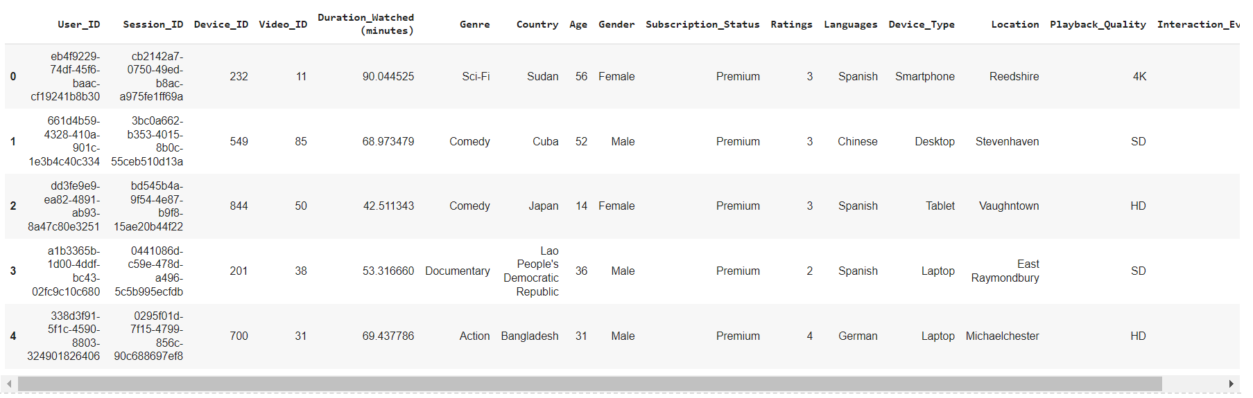
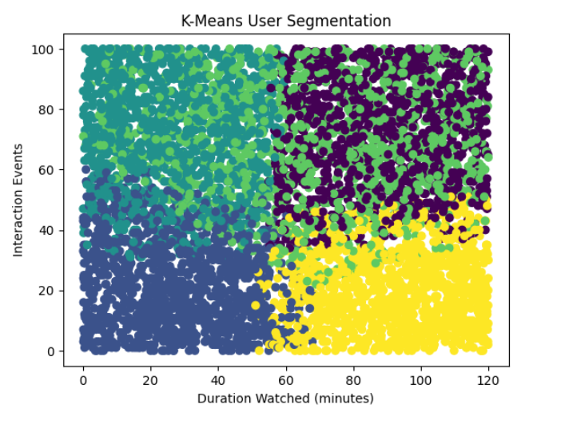
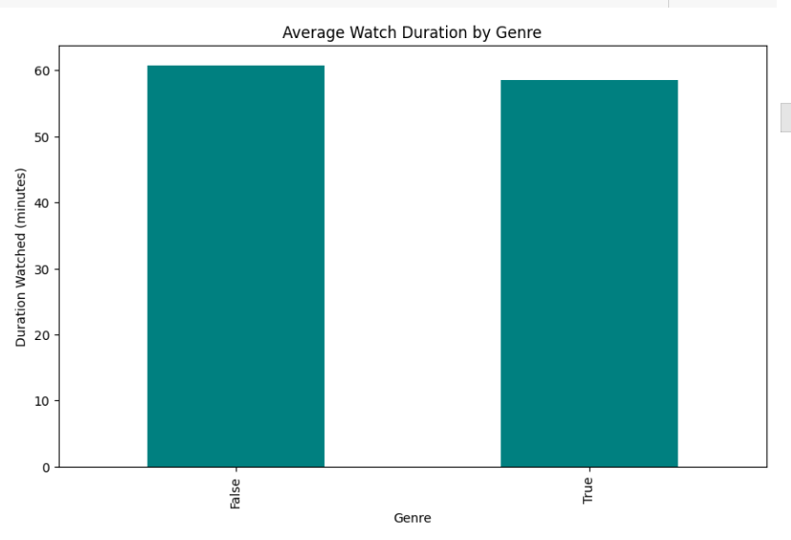
OUTPUT SCREENSHOTS:

Slide 7
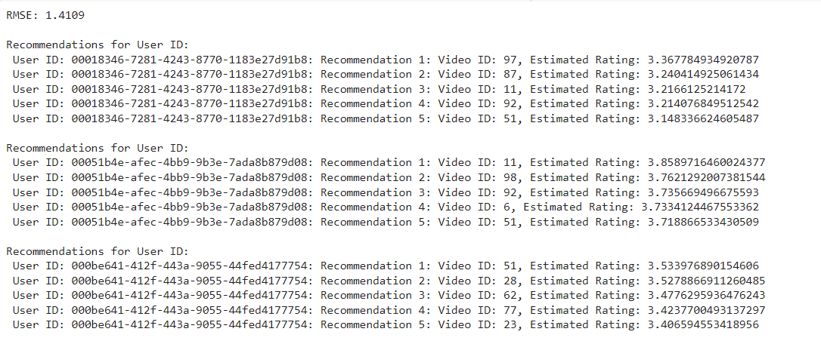
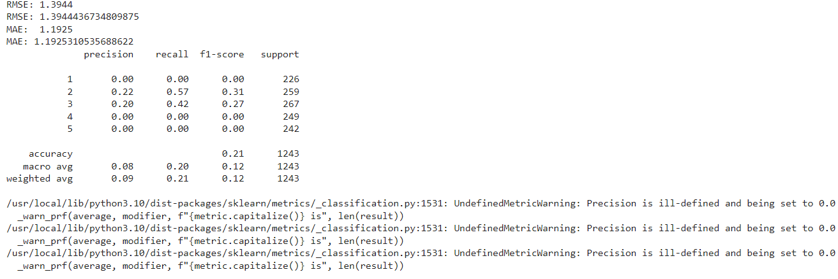
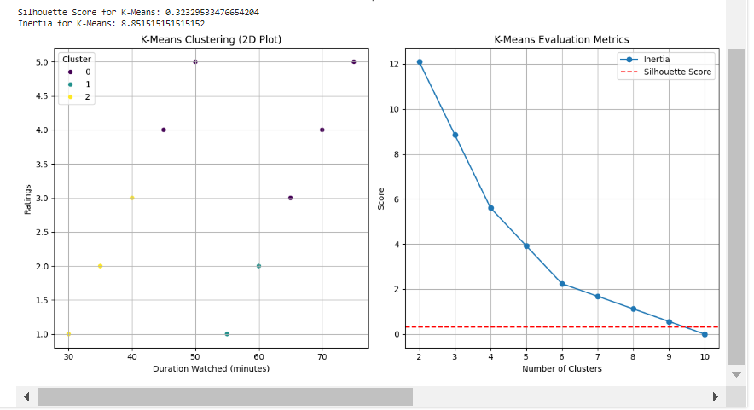

Slide 8
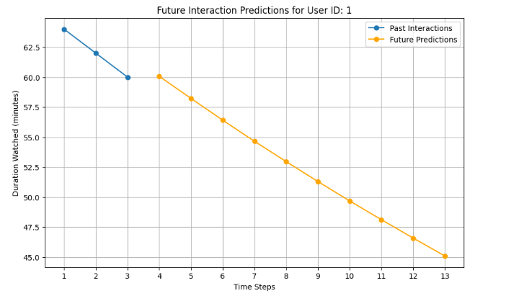
Result:
Thus enhancing Video Recommendations on Streaming Platform like youtube through User Behavior Analysis Using K-Means Clustering and Sequential Deep Learning Models (LSTM) is done successfully. Model’s performance is evaluated using following metrics.

